Slide 1
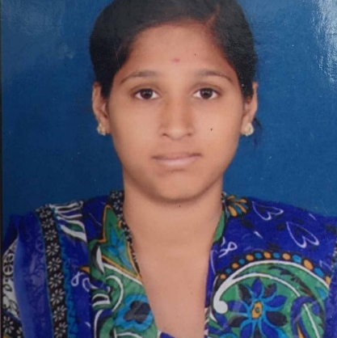


Pobbatti Vijaya Lakshmi
Bachelor of Science in Computer Science : 2019-2022
Analyst/Software Associate
Skills
C# | Basics, OOPS, Exception Handling ,Arrays ,Collection and Generics, Delegates and Events, File Io and Serialization.
.NET | ADO.NET,ASP.NET With MVC and WEB API, Entity Framework
Angular | Components , Services , Modules , Routing , Forms & Validation ,Testing
Ado.net | Basics Architecture
Database | Microsoft SQL Server
Tools | GIT,SSMS, Visual Studio , Visual Studio Code
Cloud | Microsoft Azure AZ 900,Az 104 Certified
UI Technology | HTML5 ,CSS , JavaScript & Angular
Add On Skills | Communication Skills, Team Management.
Bangalore
VIJAYA-LAKSHMI.POBBATTI@capgemini.com ,honeyvijji643@gmail.com
+91 9390781347
A3
Full Stack Developer
Hands on experience on C#,ADO.NET,SQL Server , ASP.NET MVC5 with WEBAPI.
Knowledge on creating Single Page Web Applications using Angular
Hands on experience in developing applications Web pages using HTML5, CSS3, Object Oriented Java Script.
Having Knowledge on Git and GitHub.
Attended training on iTransform-Microsoft.Net
Online Shopping Cart System:[ Video Profile]
Case study of Online Shopping Cart System using ASP.NET Core with Entity Framework ,Web API and SQL Server Management Studio , User Interface created with HTML5, CSS3 ,JavaScript and Angular. Backend with WEB API and frontend with Angular. It is a Website for Customers so that they can buy their Products in Shopping Cart System
Degreed:
Successfully completed the degreed training in Git, HTML, CSS, SQL, C#, .NET Core, Angular
Technologies used:
ANGULAR JS
ASP.NET CORE
Microsoft SQL Server
https://github.com/VPOBBATT?tab=repositories
Check out my work on GitHub

